Slide 1
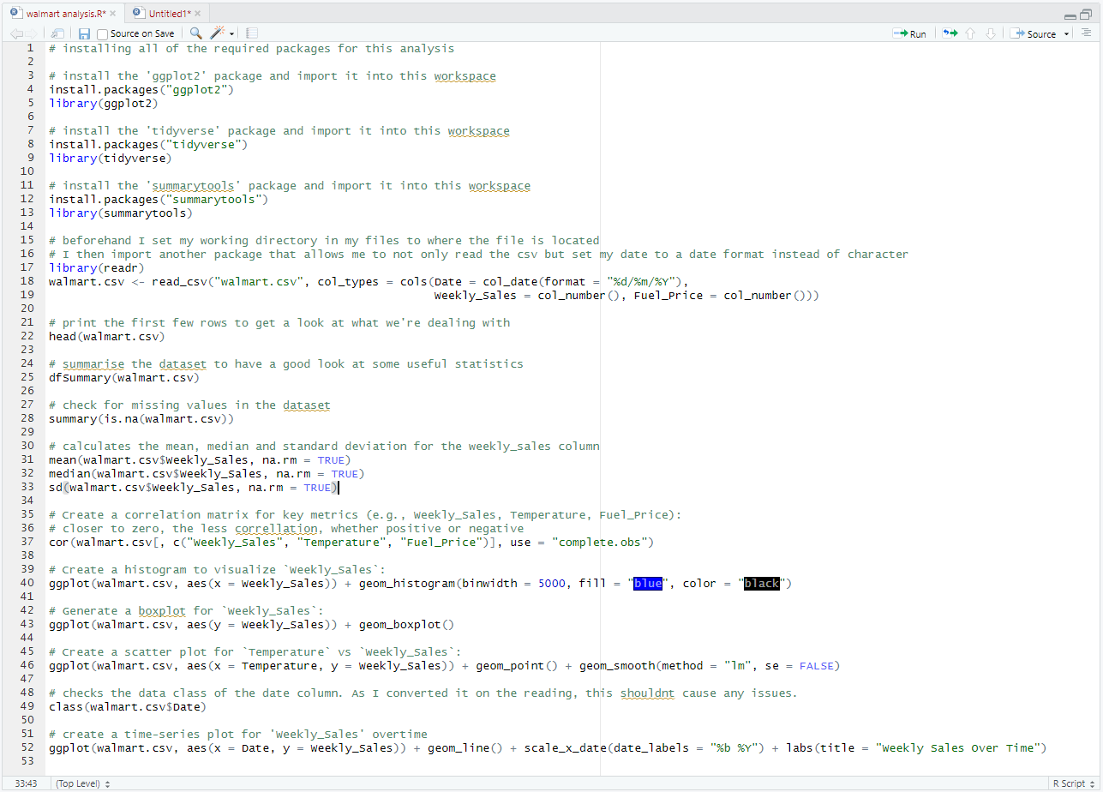
R Studio Portfolio Project
An Overview into the process

Slide 2
Project Summary
This project focuses on using the R programming language to perform an ‘EDA’ (exploratory data analysis) on a .csv dataset, using the R studio workspace. For this project, I will be using a selection of packages (containing useful functions for data analysis) in my code to help me perform some useful visualisations and essential setup beforehand:
ggplot2: an essential toolkit for creating graphical visualisations in the workspace
tidyverse: a useful package for data manipulation, exploration, and generally helping to tidy data.
summarytools: Allows me to return summaries of data including important aspects such as the mean, mode and standard deviation in a compact format
readr: While the other packages alone allow me to read my csv file and place it into a variable, this package allows me to have greater control over the formats of each column, which is very important for how I will be using my data in visualisations.

Slide 3
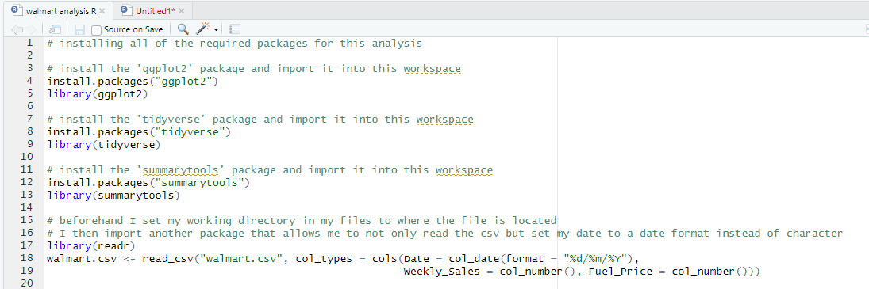
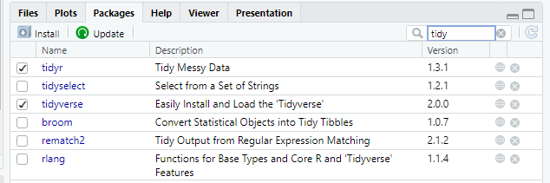

Importing my Data
Not only do my packages need to be installed, but they also need to be imported into this workspace as well to be usable. My files window helps me keep track of everything here.

Slide 4
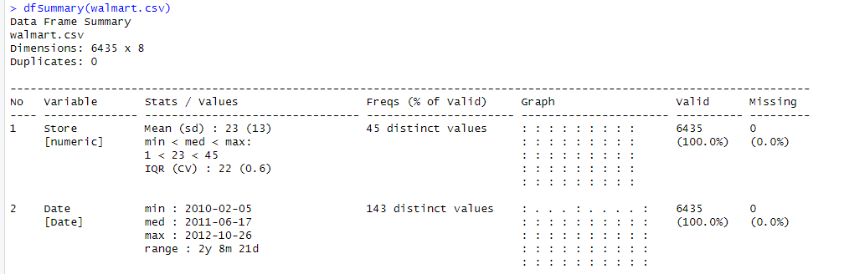
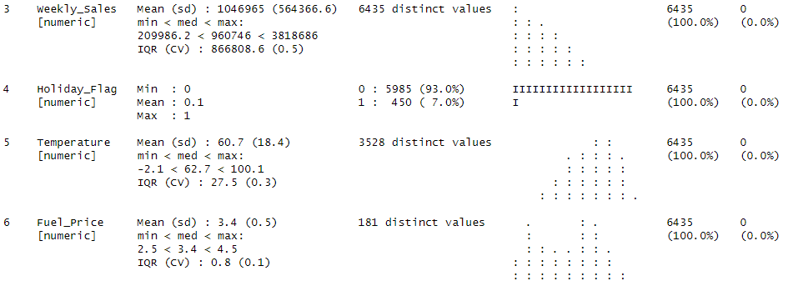
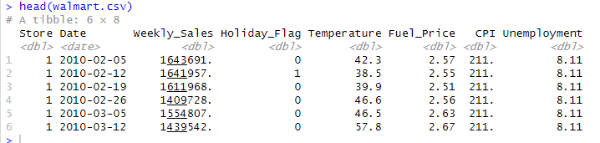
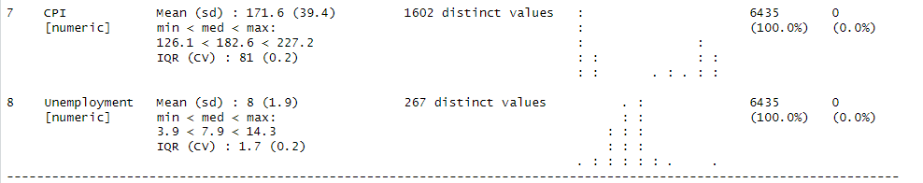



Exploratory Data Analysis
Certain functions such as head() give me a quick way of accessing the table contents in R to see how they transferred across. dfSummary() grants a more comprehensive summary, which allowed me to look at crucial points such as the minimum, maximum and mean values, while also checking to see if there are any null values that may interfere with my analysis.

Slide 5


Exploratory Data Analysis
Next, I looked at using the mean(), median() and sd() to look at the mean, median and standard deviation for the weekly sales column. I also had a look at the correlation between three of the columns using the cor() function to create a correlation matrix. None of the values had correlation of any kind.
Being able to fetch these at any time can be handy as you can insert these functions into other more complex calculations further ahead.

Slide 6
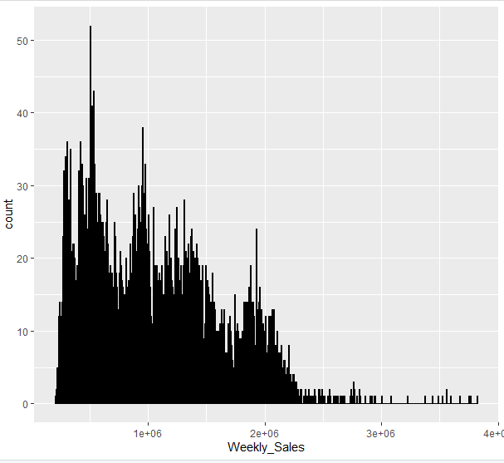
Graph Plotting
Having reviewed my data and noted useful points on how it relates to each other, I set out to create some graphs to visualise it through R studio.
The ggplot() function allows me to create a variety of plots in my files window in R studio, including a histogram, box plot, scatter graph and time-series plot.
From what we can see on this histogram, the data in this dataset has a strong positive skew.

Slide 7
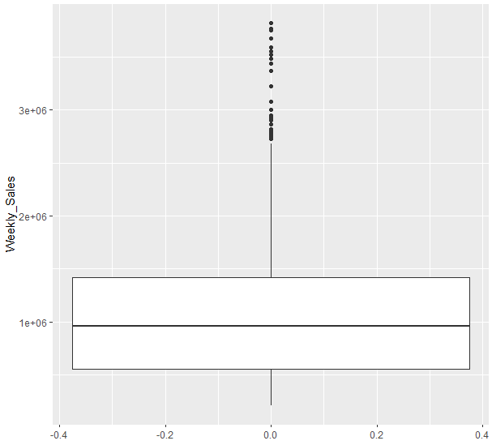
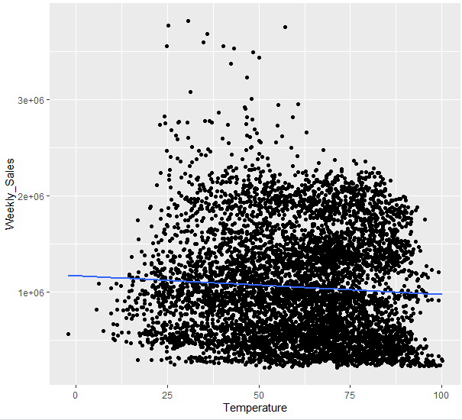
Graph Plotting
Box Plot
Scatter Plot

Slide 8
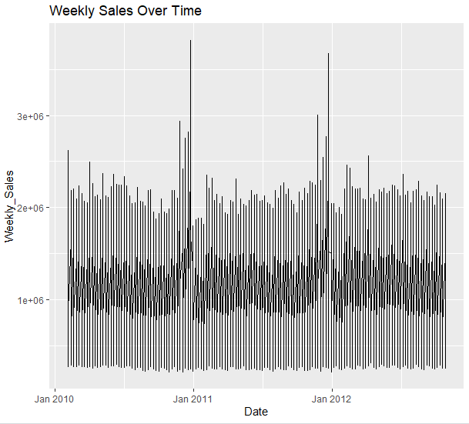
Graph Plotting
Remember how I adjusted the data class of the ‘Date’ column? Doing so prevented an error from occurring with this code as it would have recognised the date values as texts rather than its own ‘date’ type. This was something I had to do retroactively to allow this code to work.

Slide 9
Final Script
Overall, a lot can be accomplished with relatively little when it comes to using R, given how people in the community contribute packages to help streamline the data analysis process for everybody, and with skills developed in PowerBI and Excel, it is reasonable to see how R to be part of a much larger workflow involving ETL (Extract, Transform, Load) processes and dedicated data visualisation software.

